Slide 1

Machine Learning & Artificial Intelligence
Instructors: Vikranth Jeyakumar, Tianmu Li

Slide 2
In This Lecture
What is Machine Learning?
Linear regression
Bayesian Learning
Deep Learning (DL)
Tutorial on DL

Slide 3
In This Lecture
What is Machine Learning?
Linear regression
Bayesian Learning
Deep Learning (DL)
Tutorial on DL

Slide 4
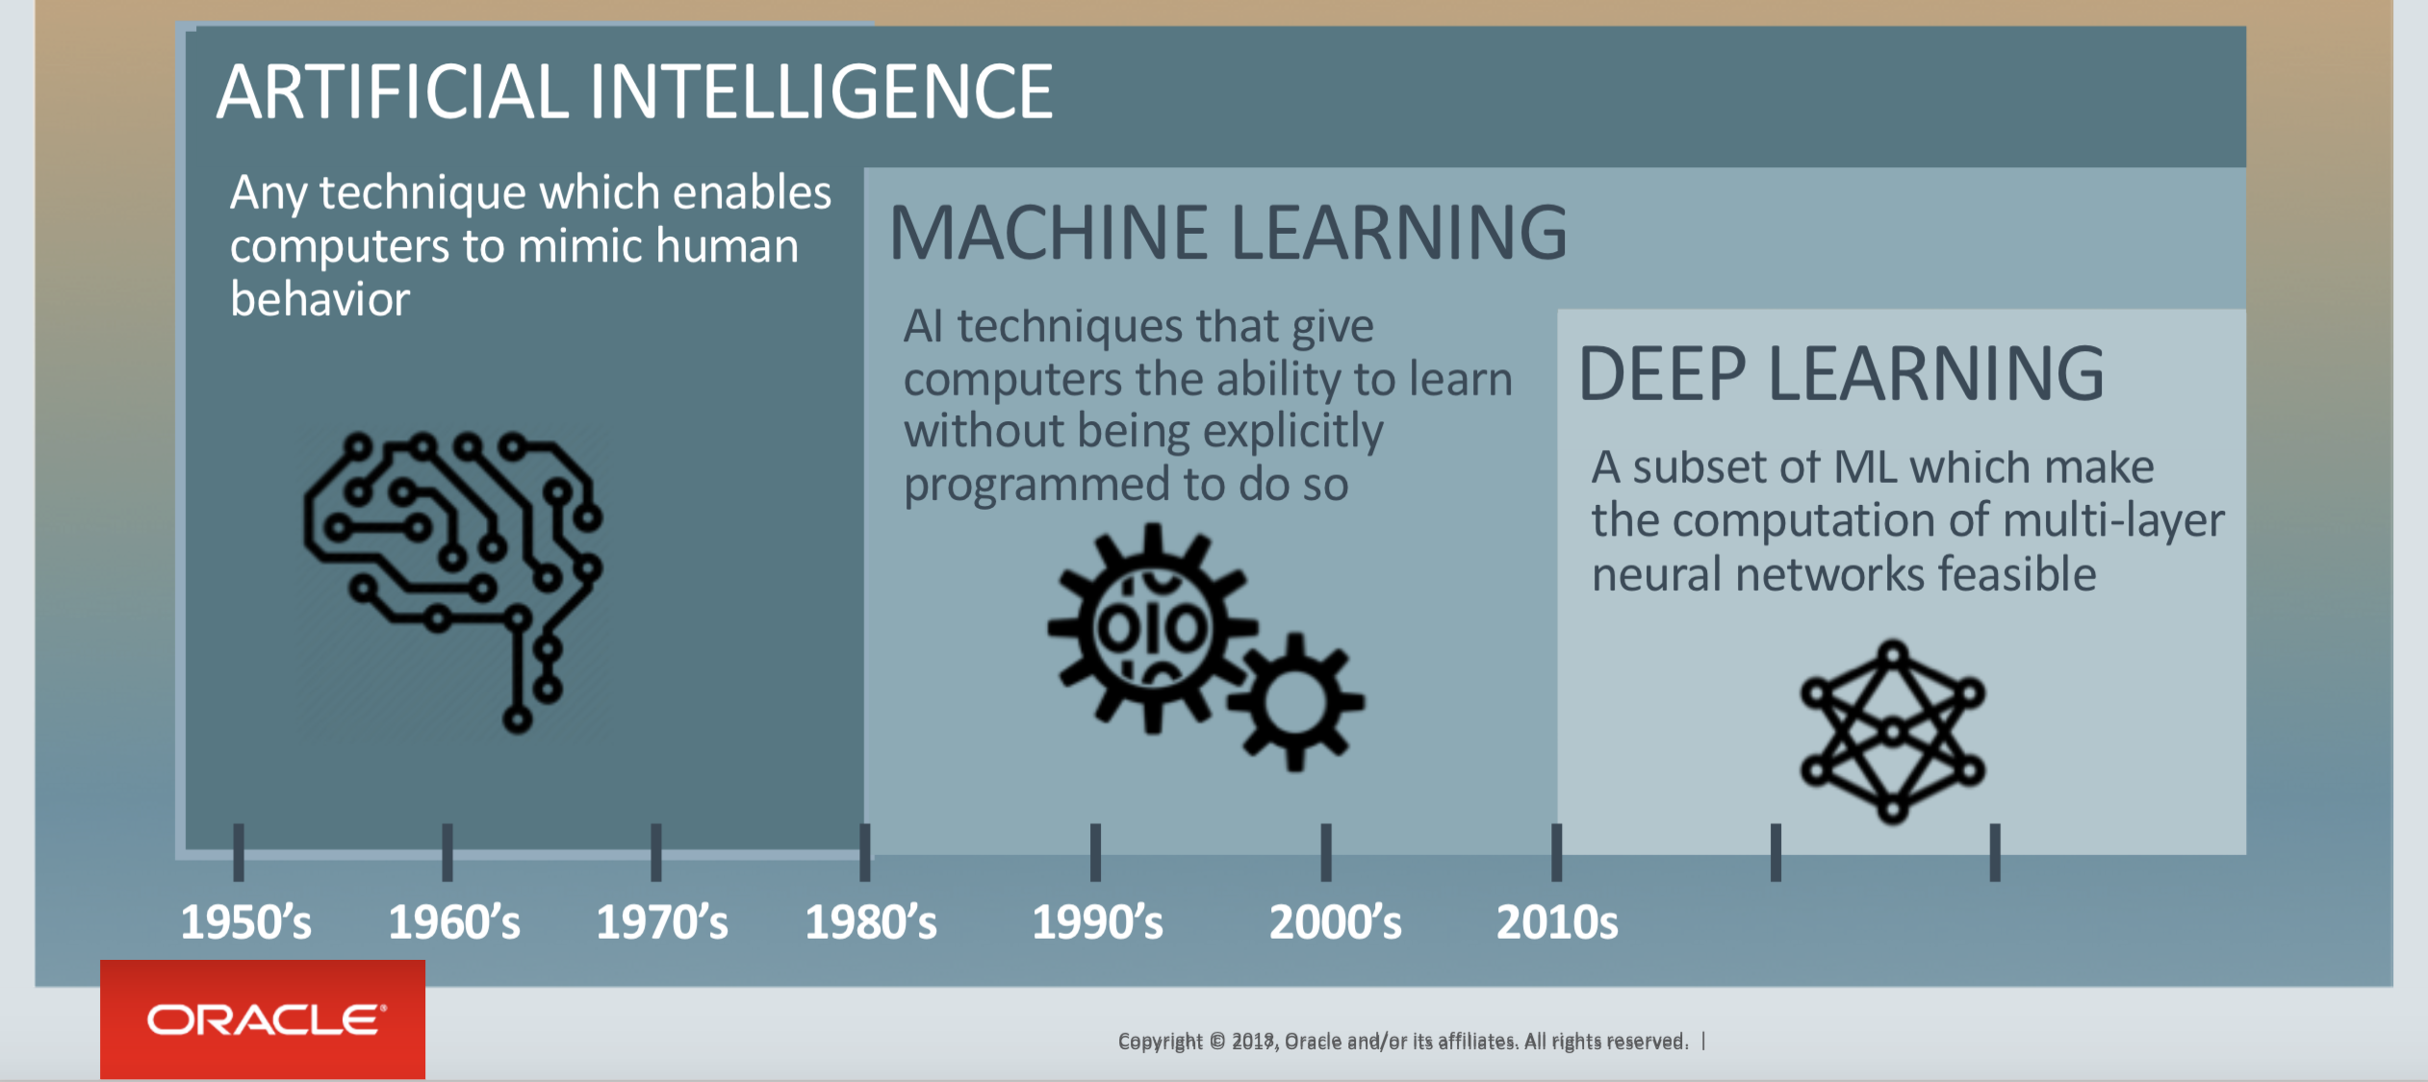
Difference between AI, ML and DL

Slide 5
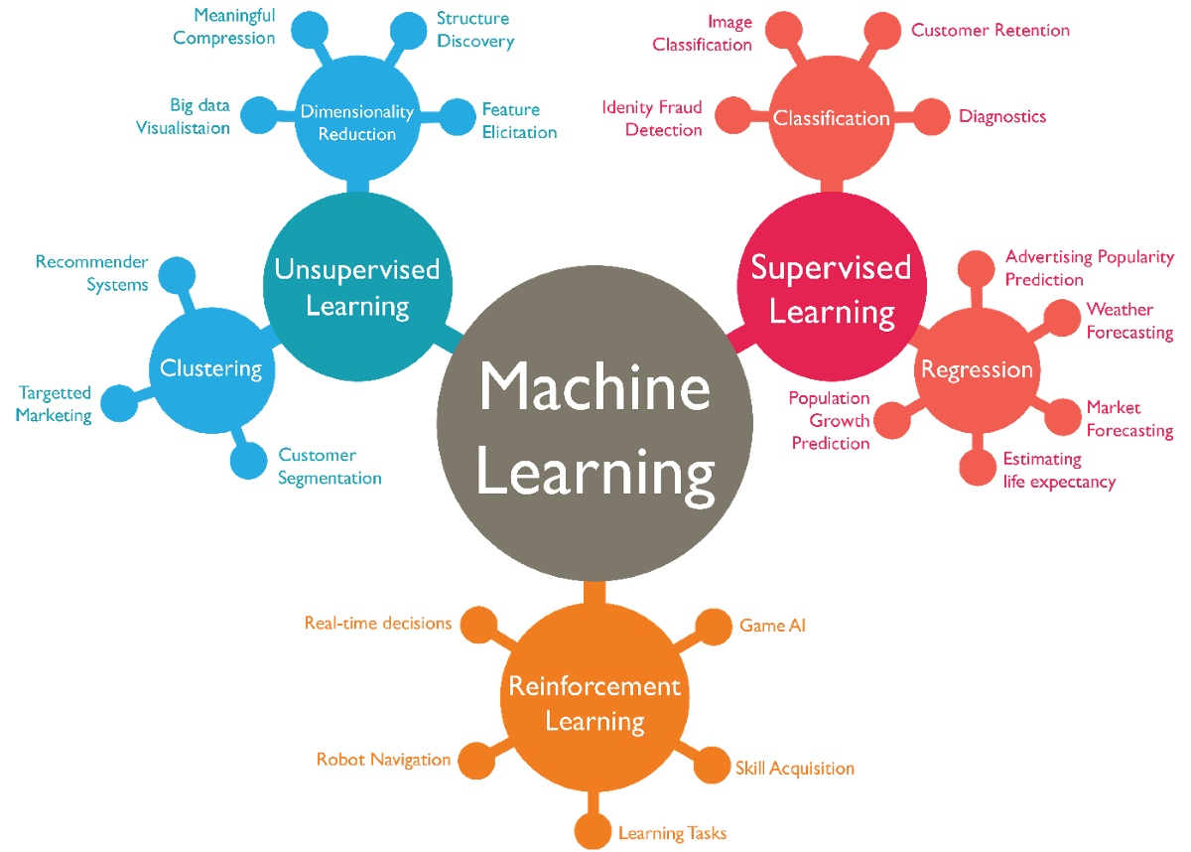

Slide 6
In This Lecture
What is Machine Learning?
Linear regression
Bayesian Learning
Deep Learning (DL)
Tutorial on DL

Slide 7
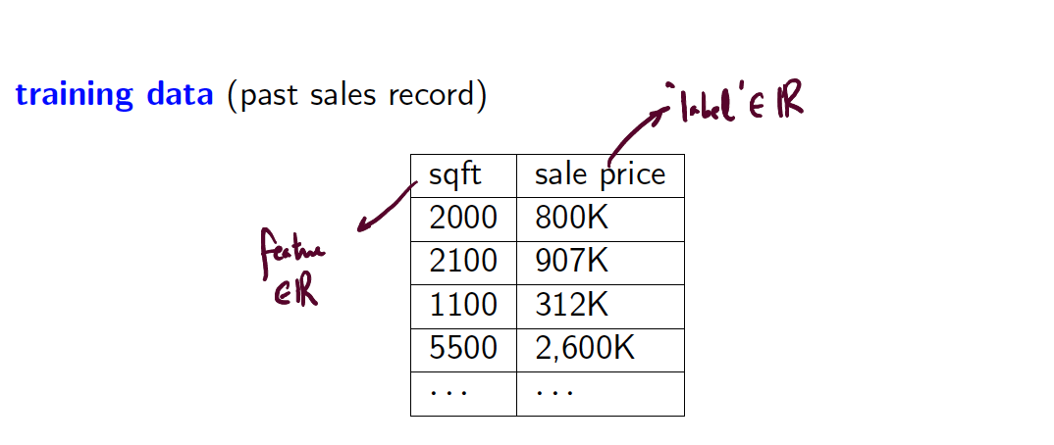
Linear Regression

Slide 8
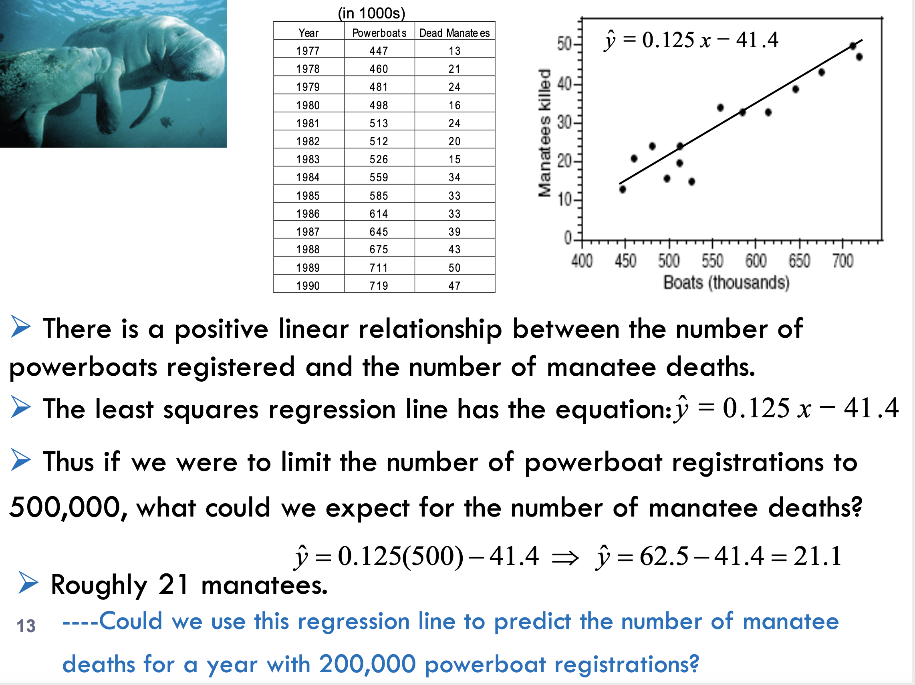

Slide 9
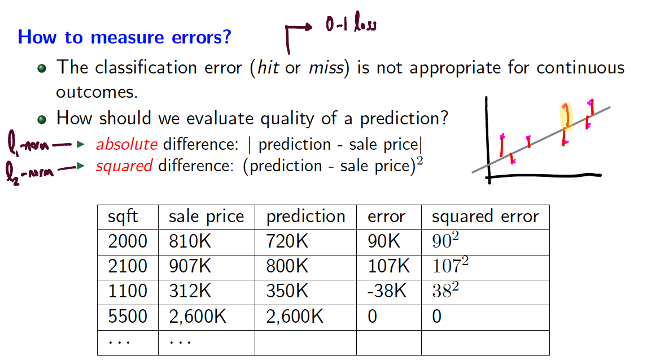
Linear Regression

Slide 10
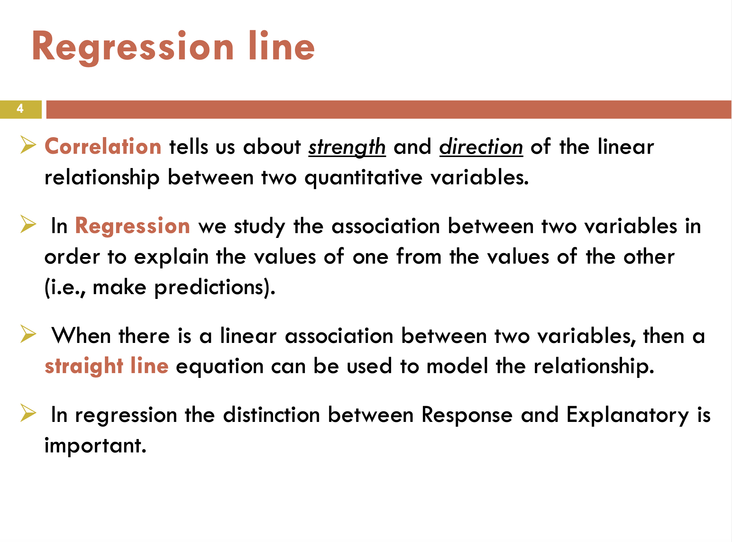

Slide 11
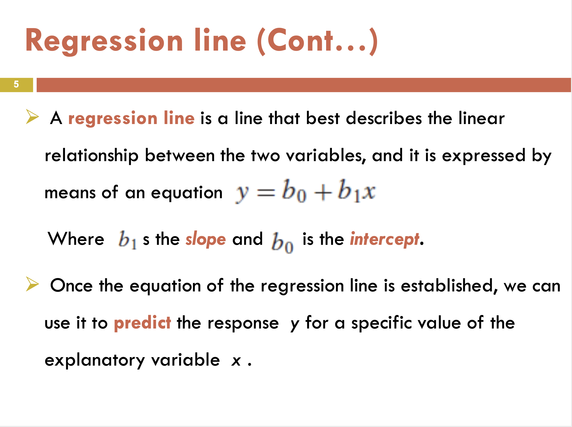

Slide 12
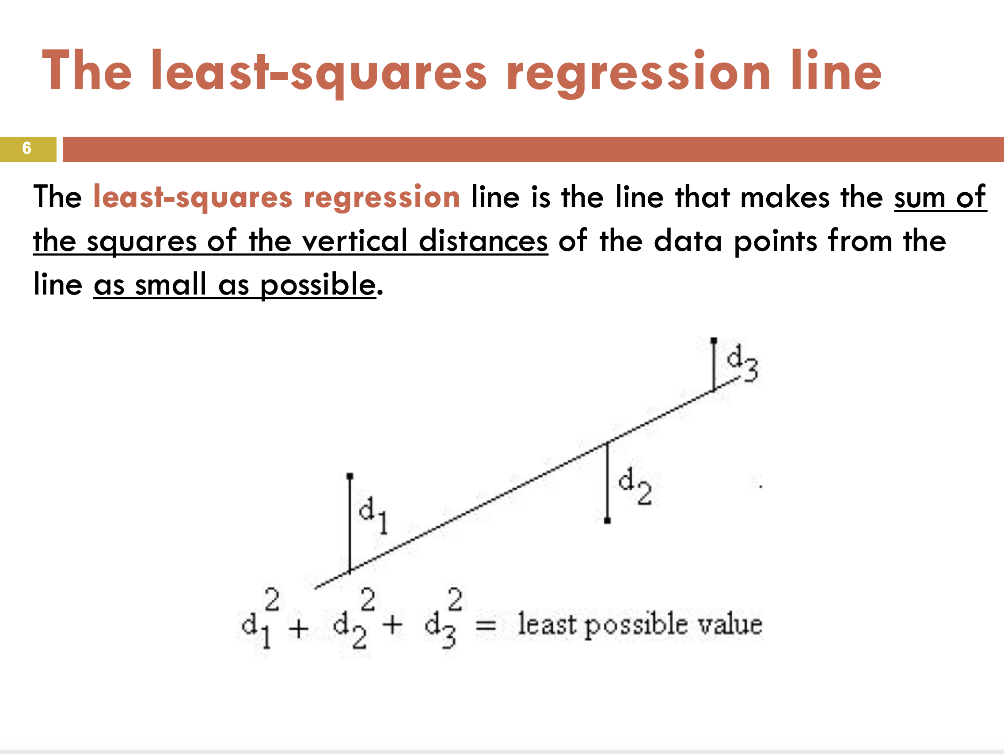

Slide 13
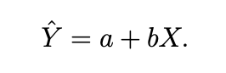
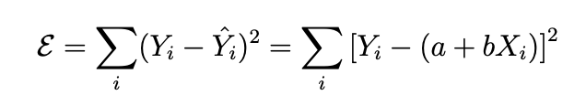
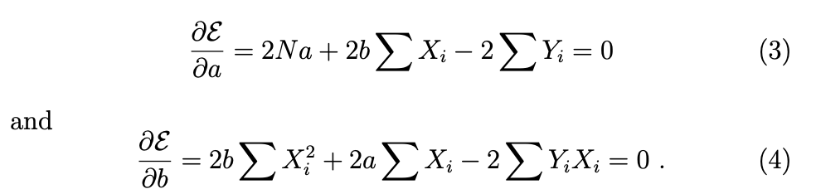
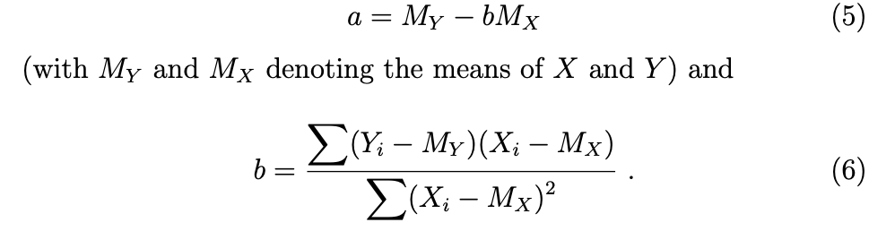
Analytical solution

Slide 14
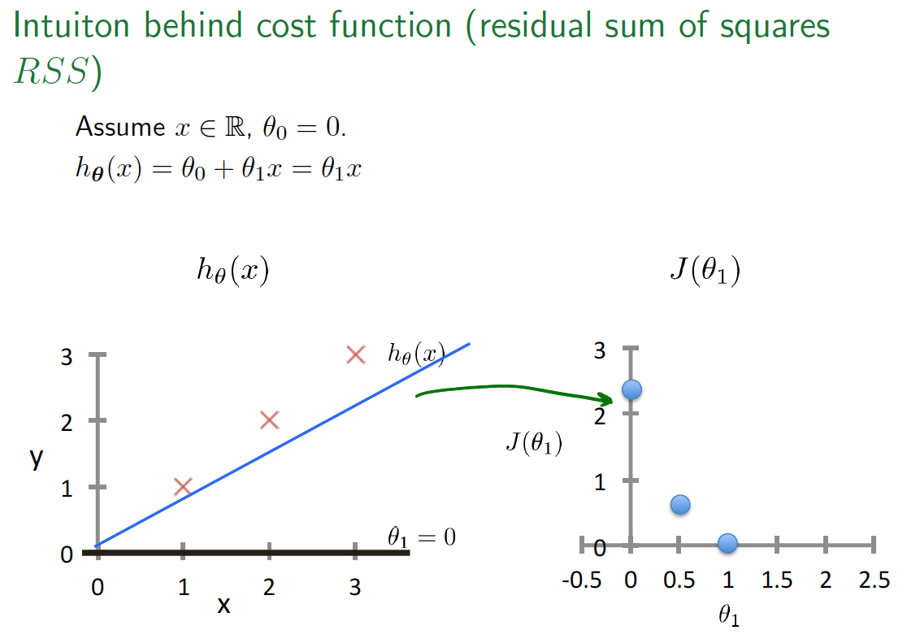

Slide 15
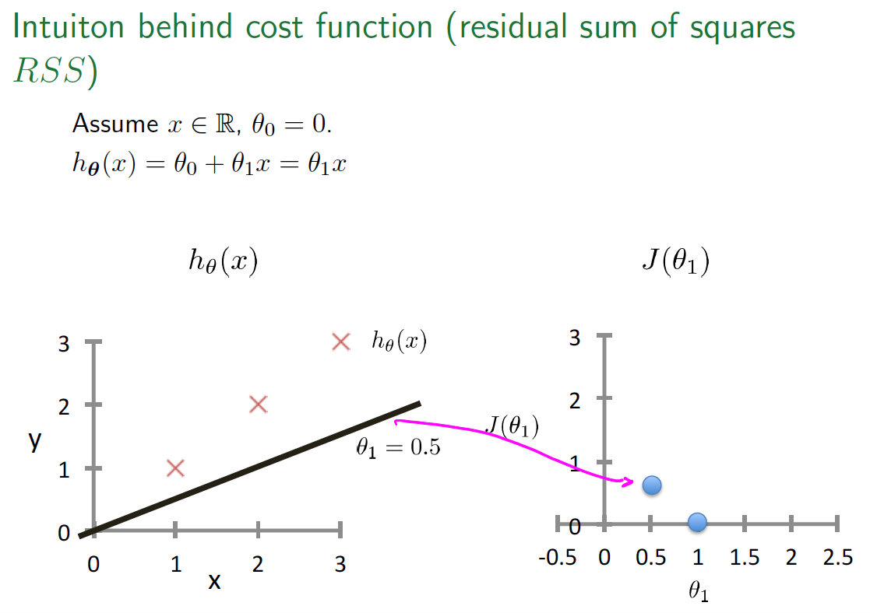

Slide 16
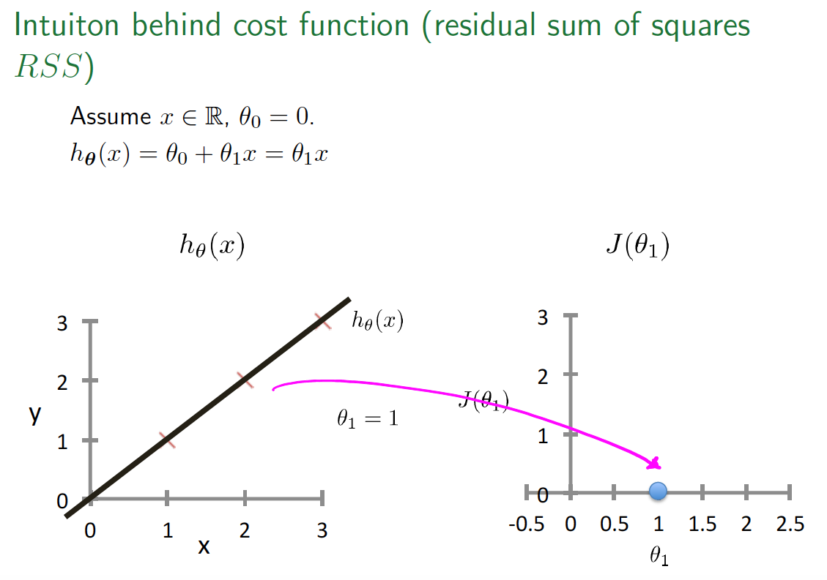

Slide 17
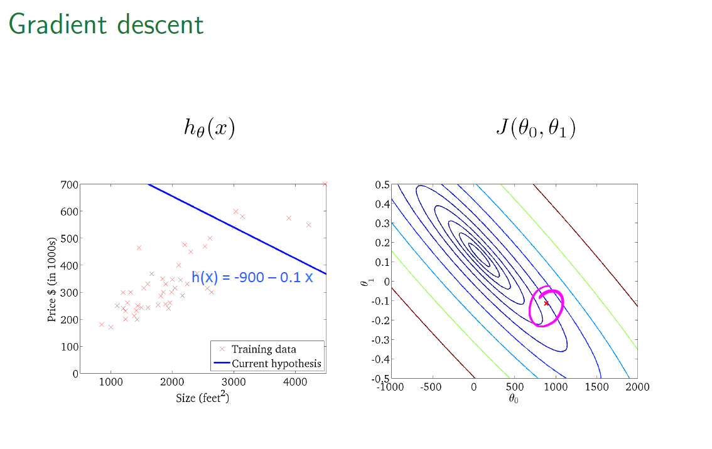

Slide 18
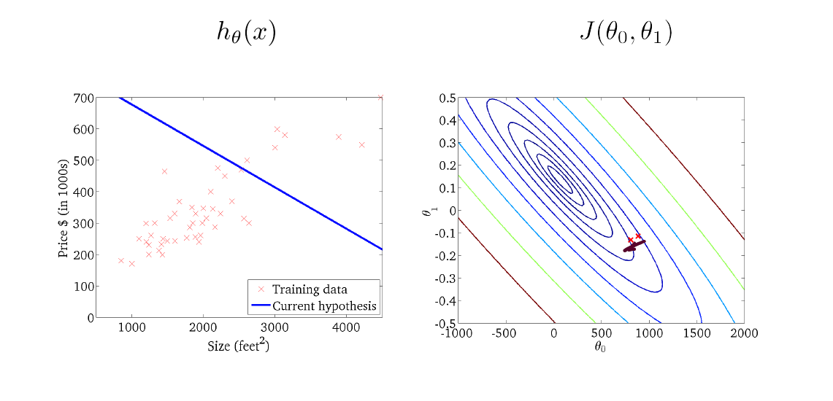
Gradient Descent

Slide 19
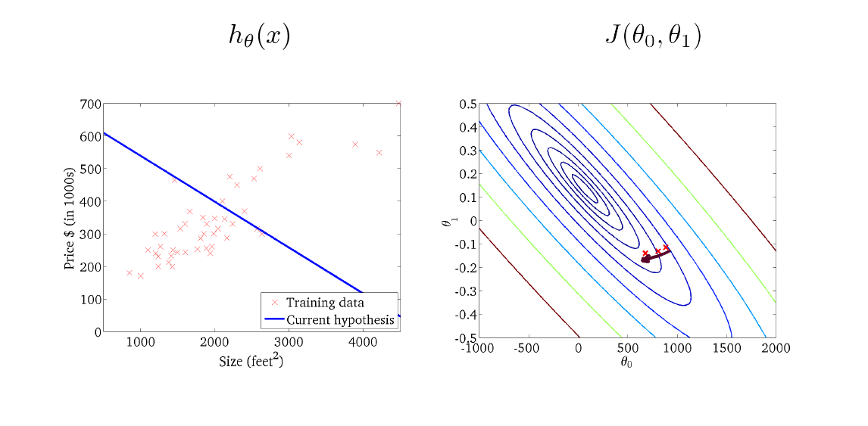
Gradient Descent

Slide 20
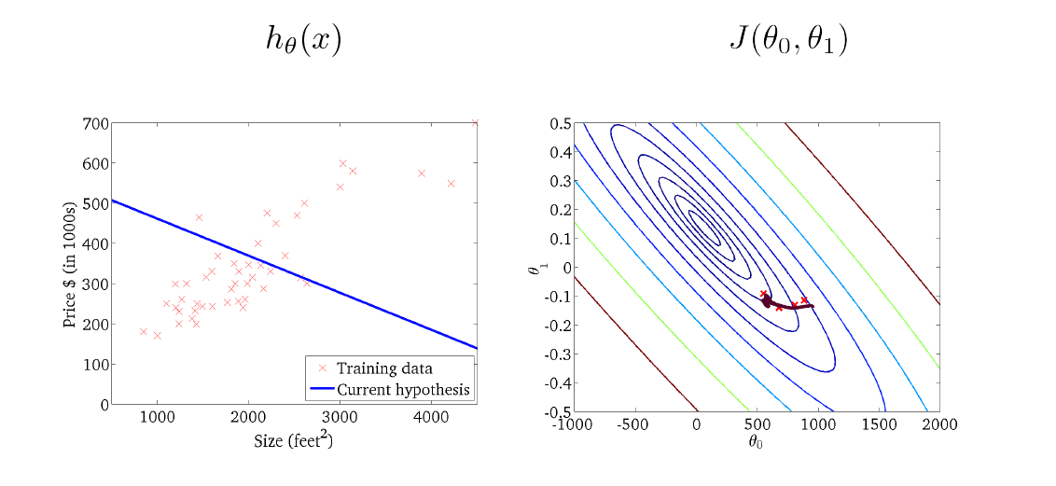
Gradient Descent

Slide 21
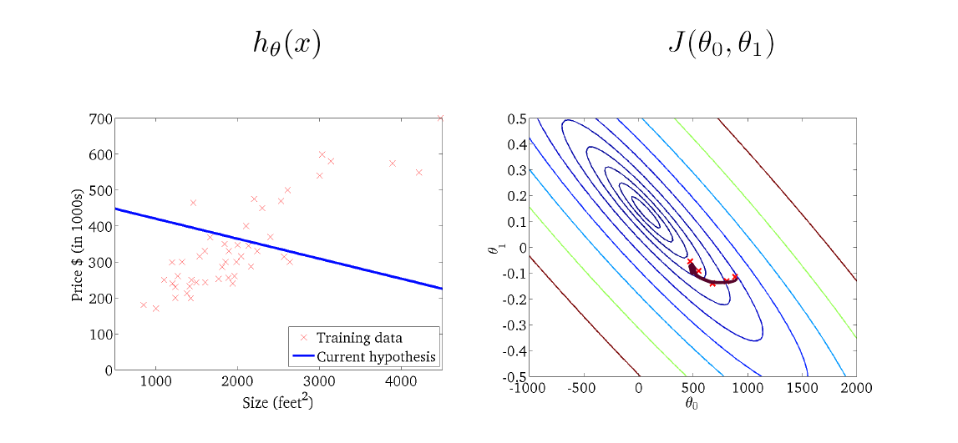
Gradient Descent

Slide 22
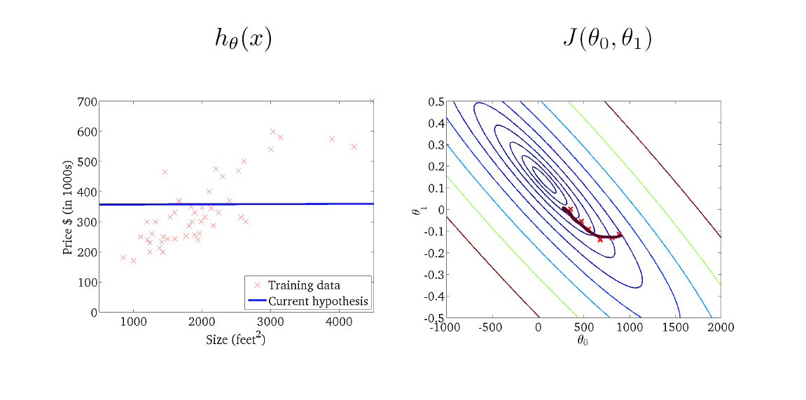
Gradient Descent

Slide 23
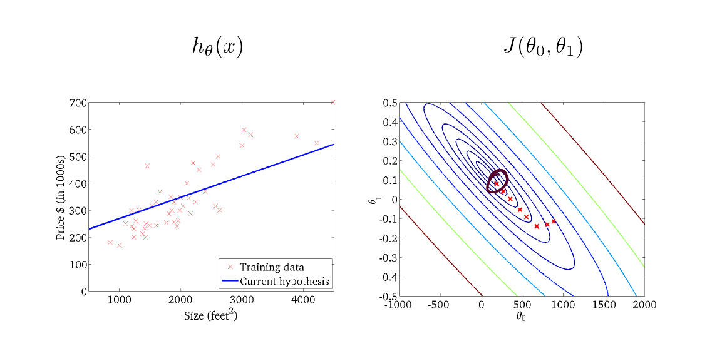
Gradient Descent

Slide 24
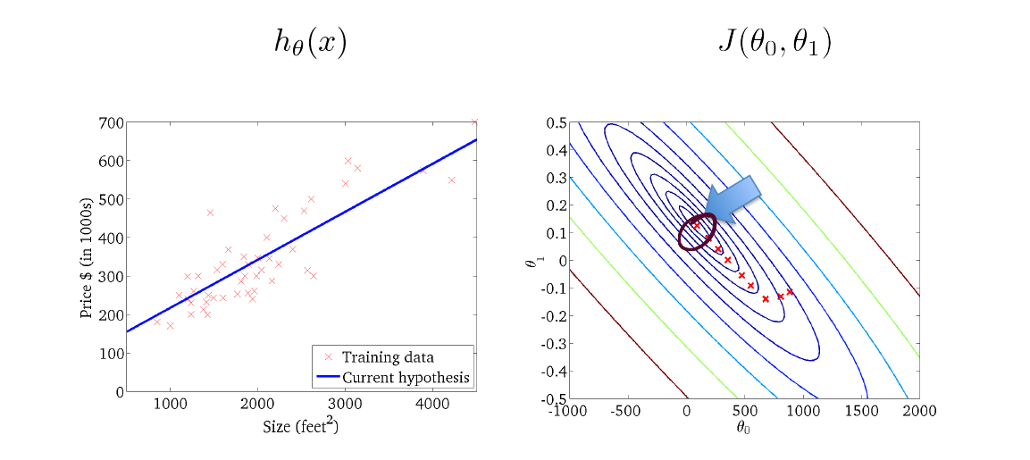
Gradient Descent

Slide 25
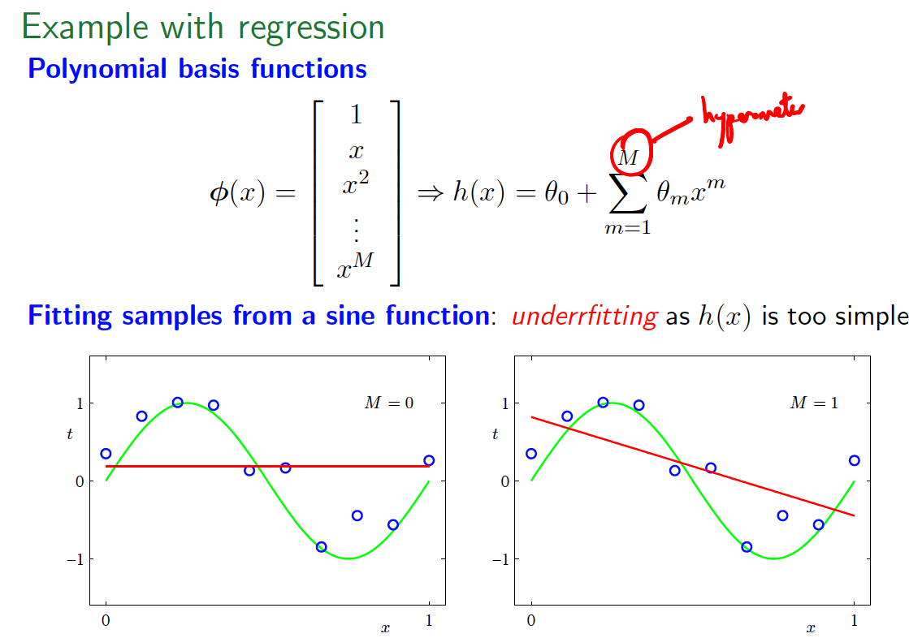

Slide 26
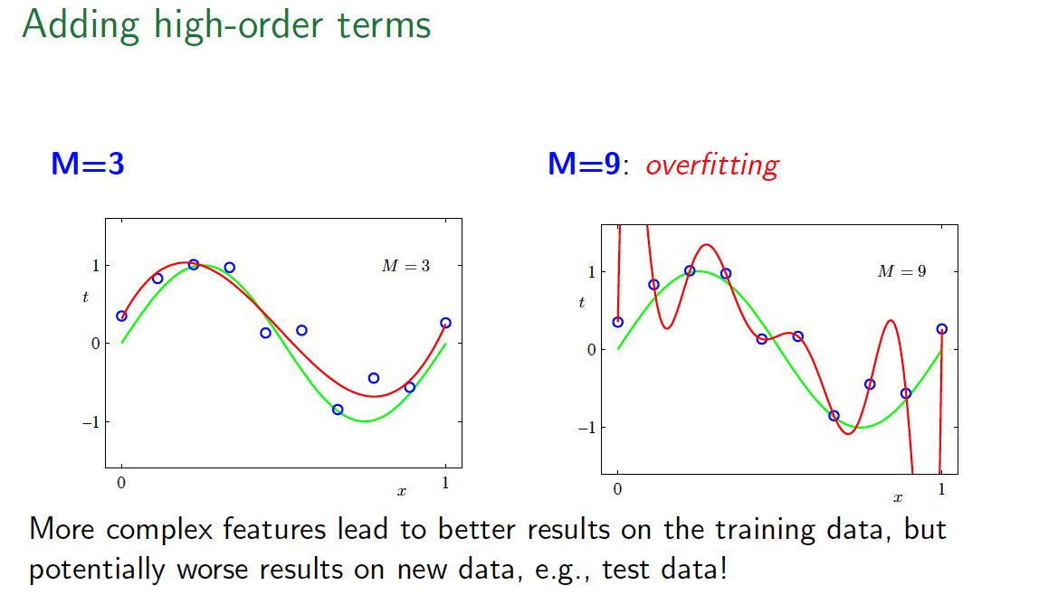

Slide 27
In This Lecture
What is Machine Learning?
Linear regression
Bayesian Learning
Deep Learning (DL)
Tutorial on DL

Slide 28


Slide 29


Slide 30


Slide 31
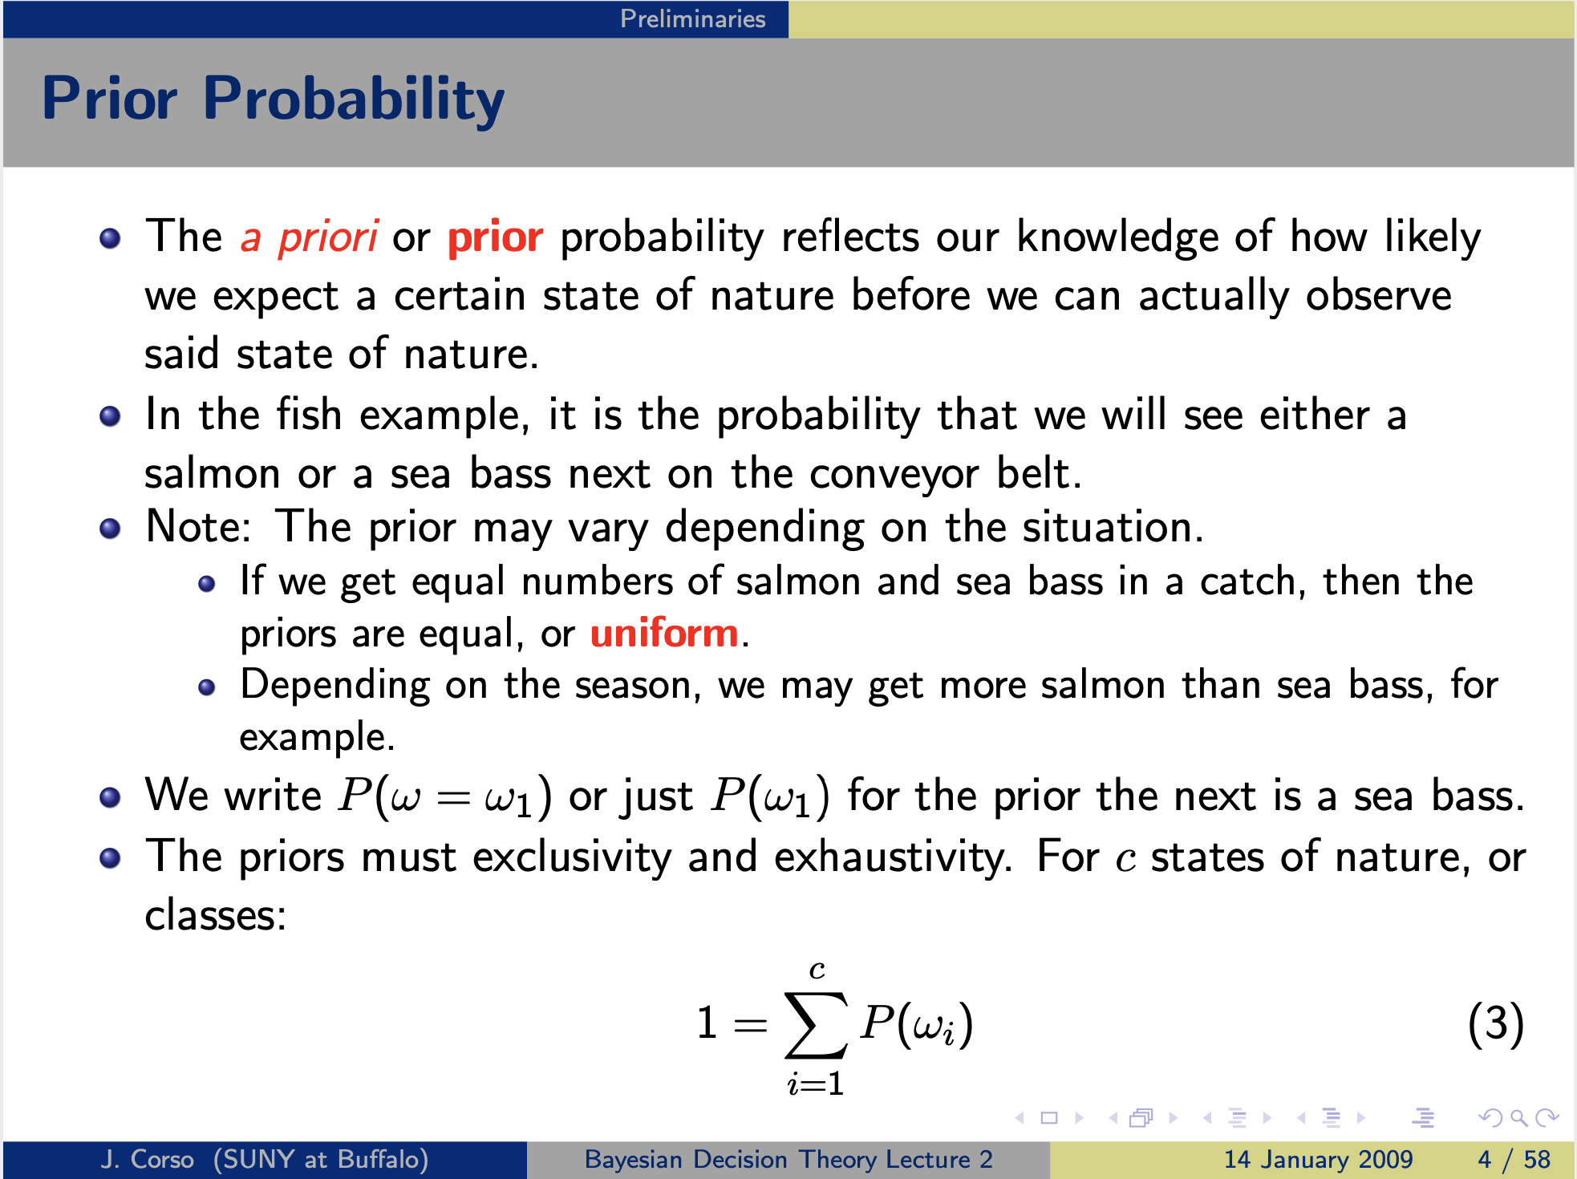

Slide 32
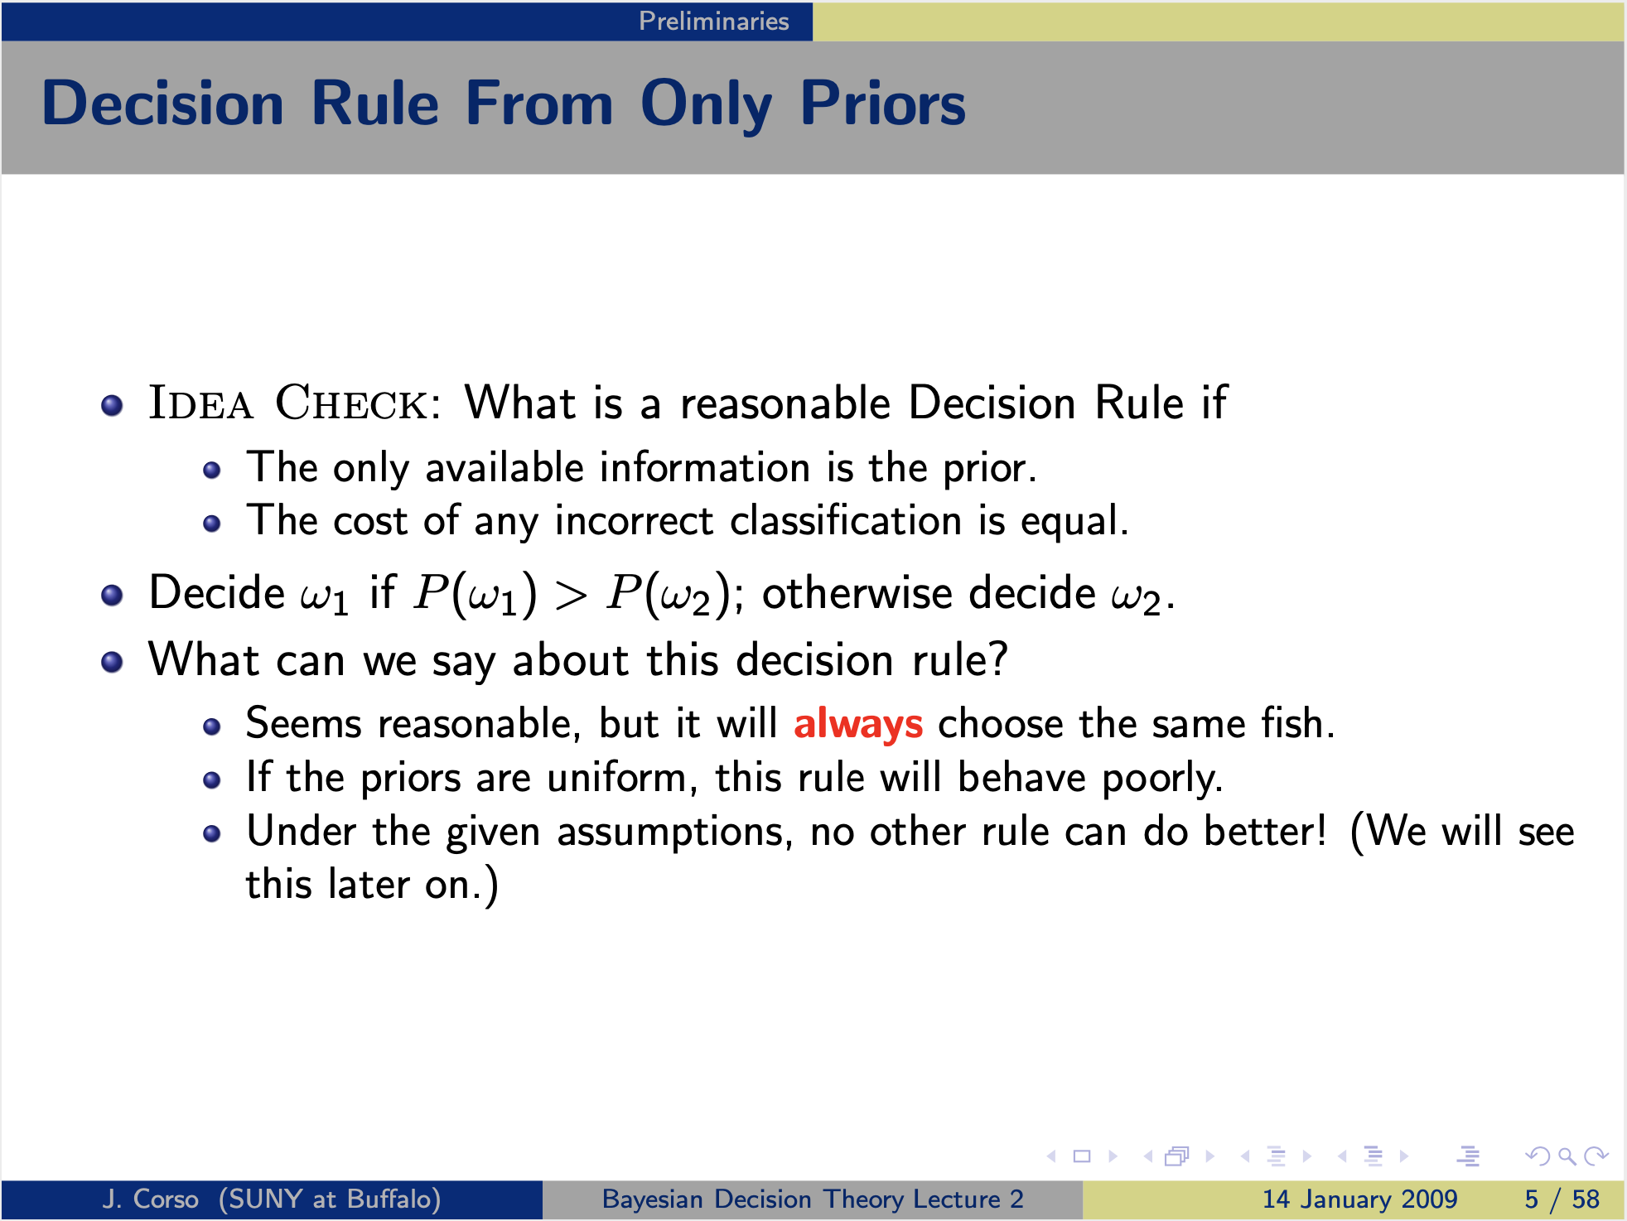

Slide 33
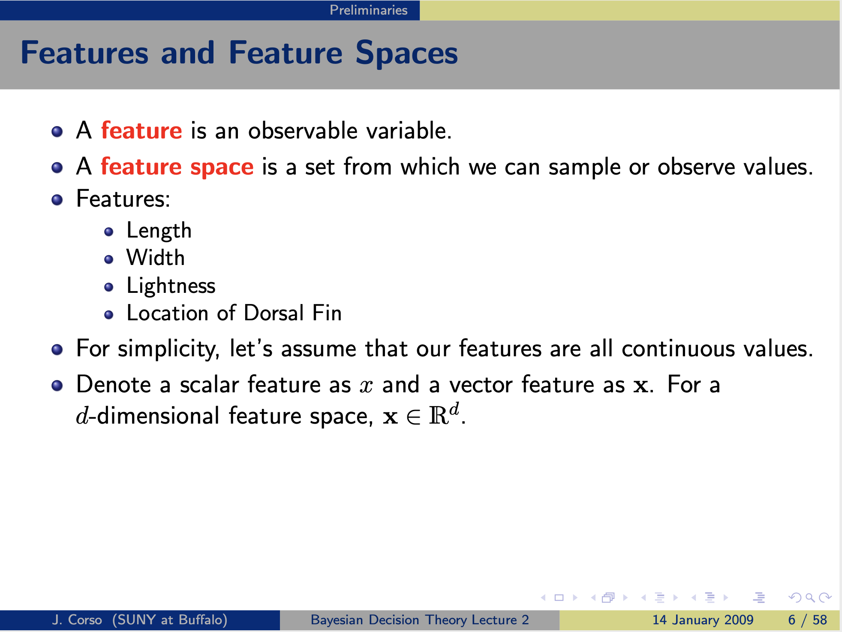

Slide 34
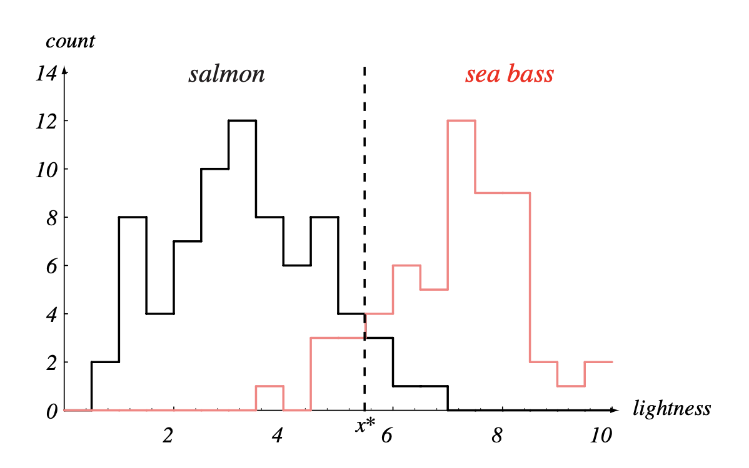
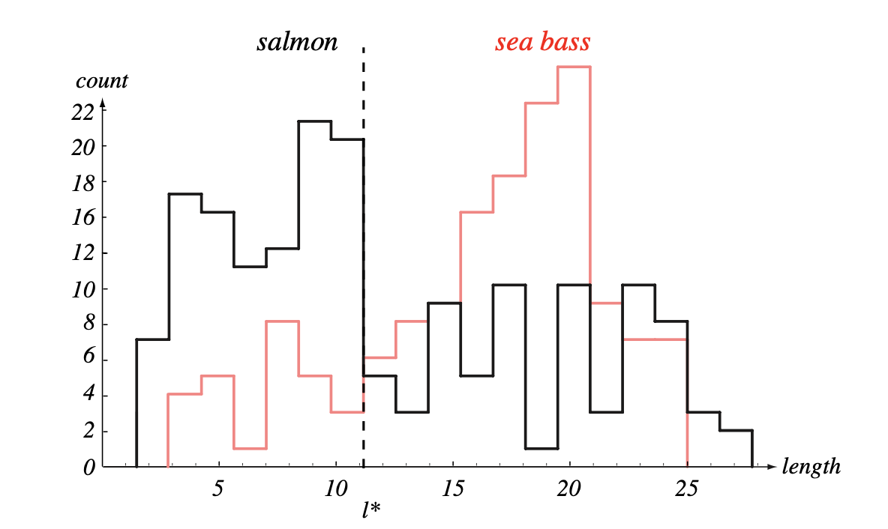
Class probability density
Histogram of lightness feature
Histogram of length feature

Slide 35
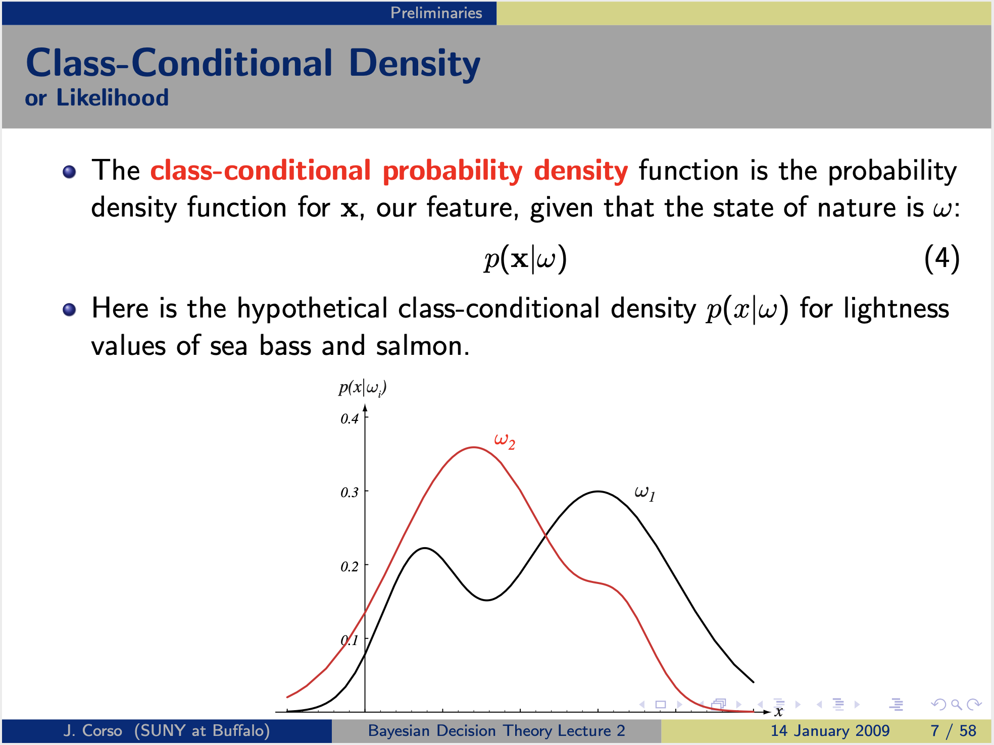

Slide 36
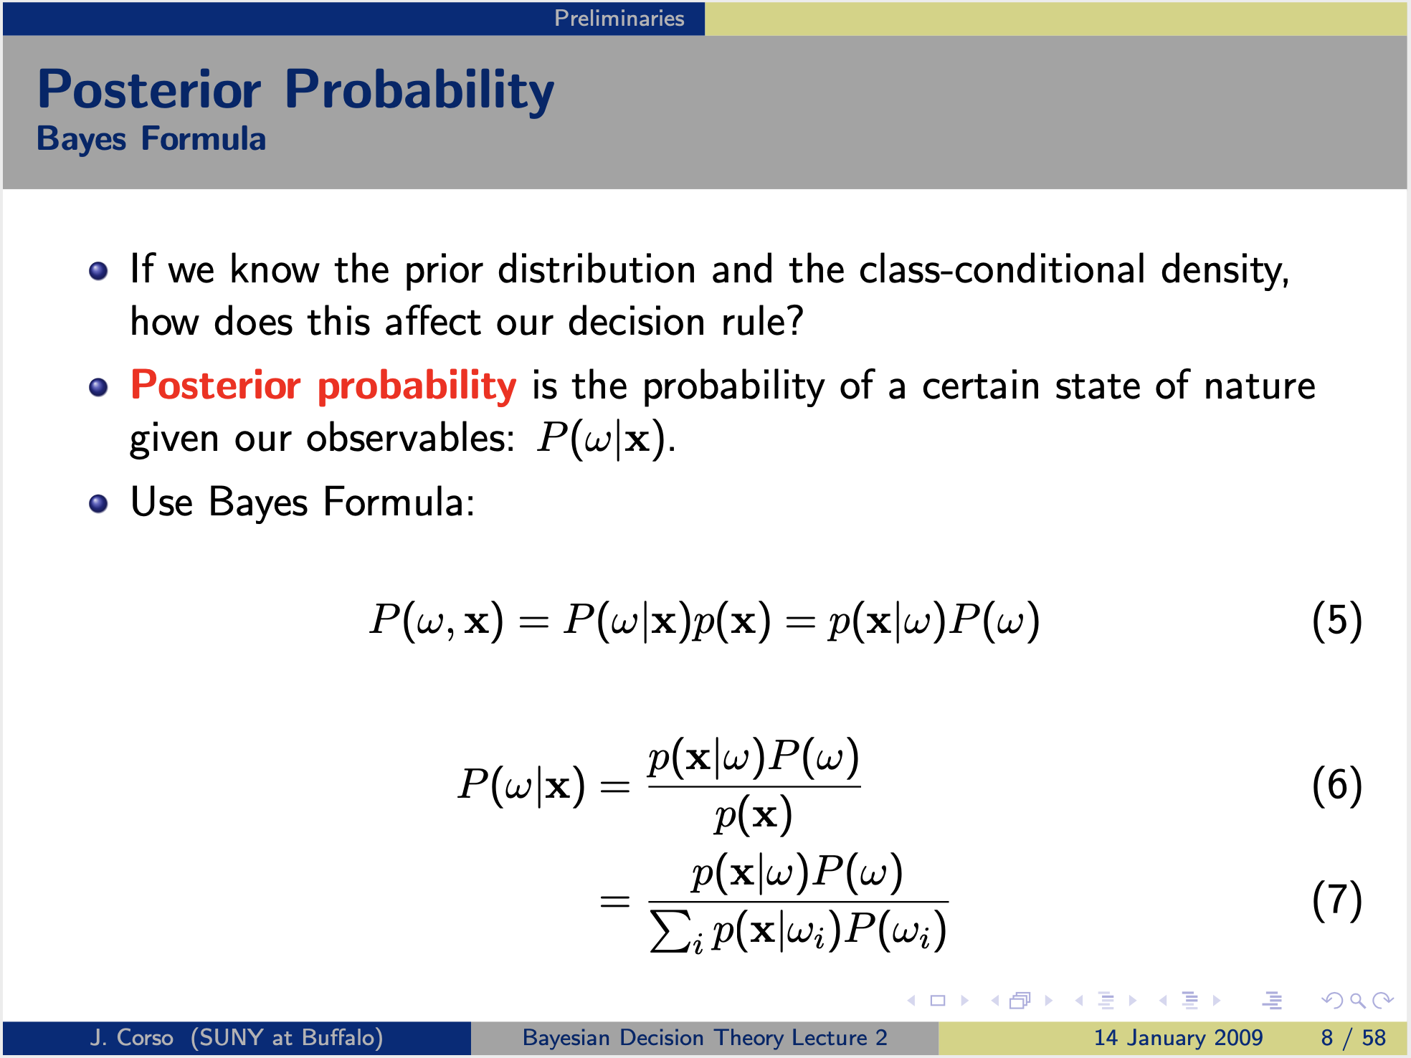

Slide 37
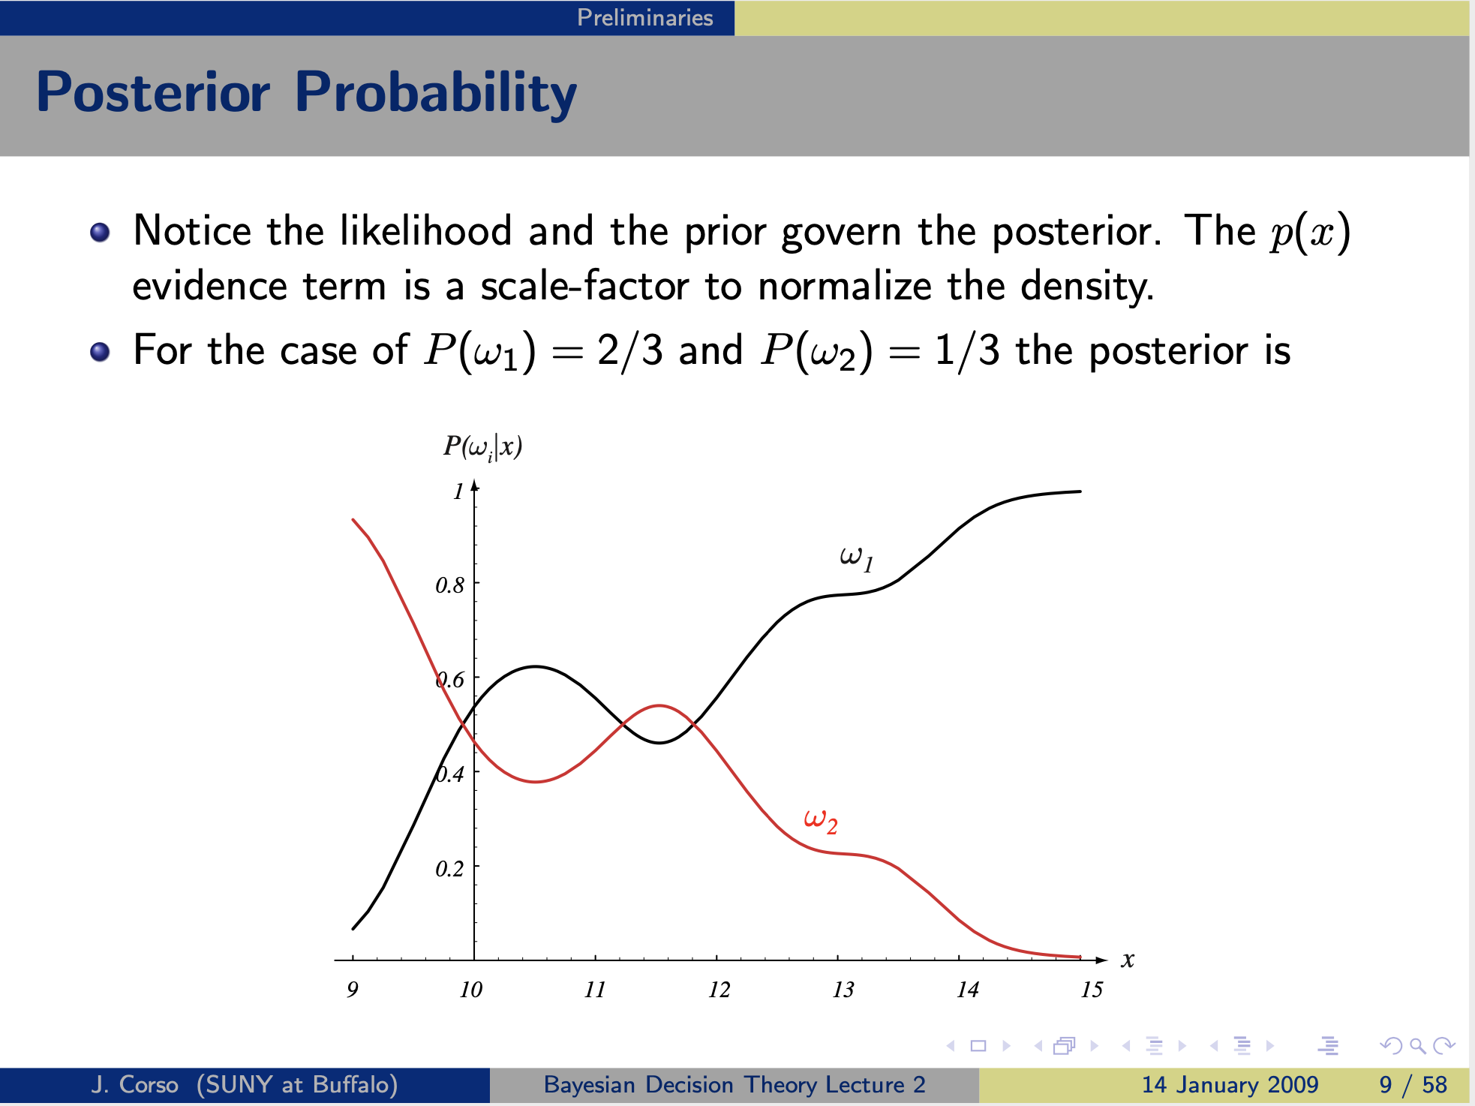

Slide 38
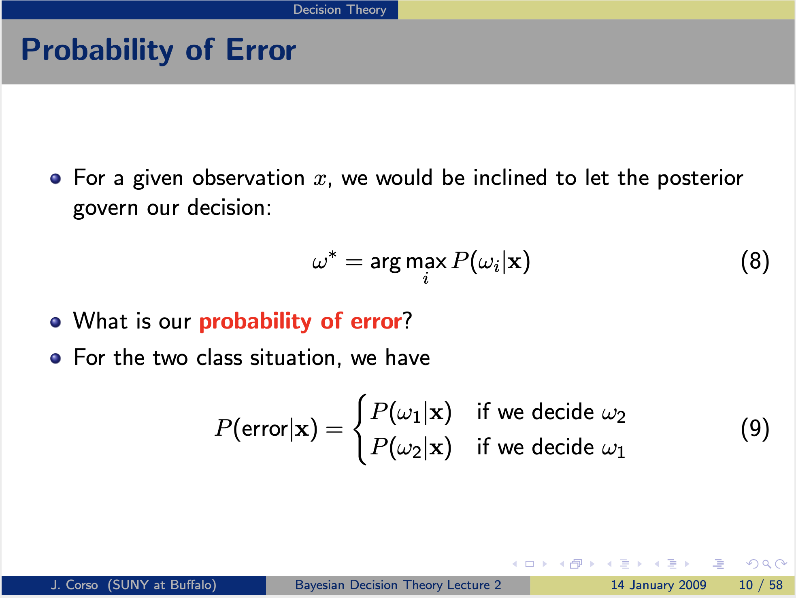

Slide 39
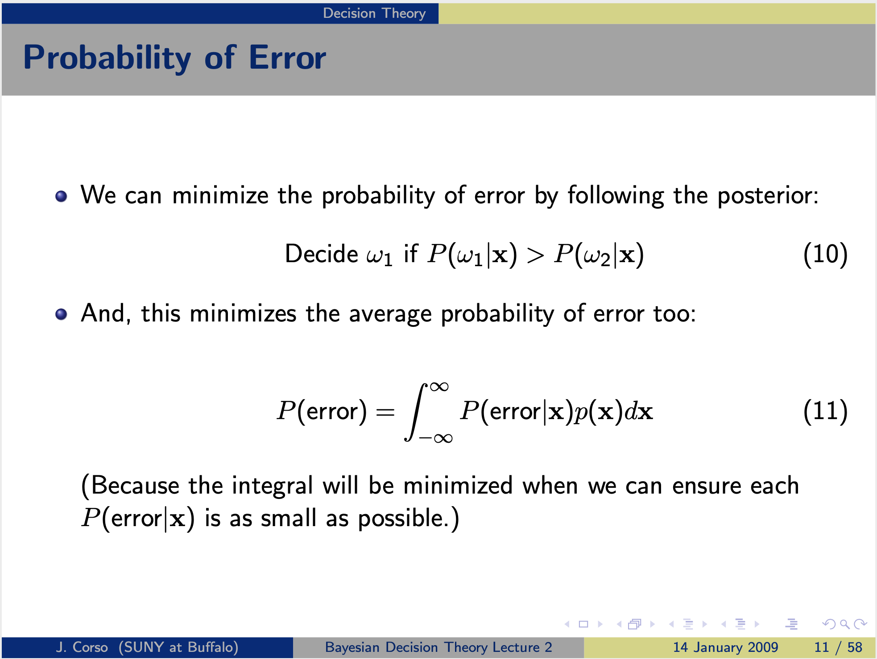

Slide 40
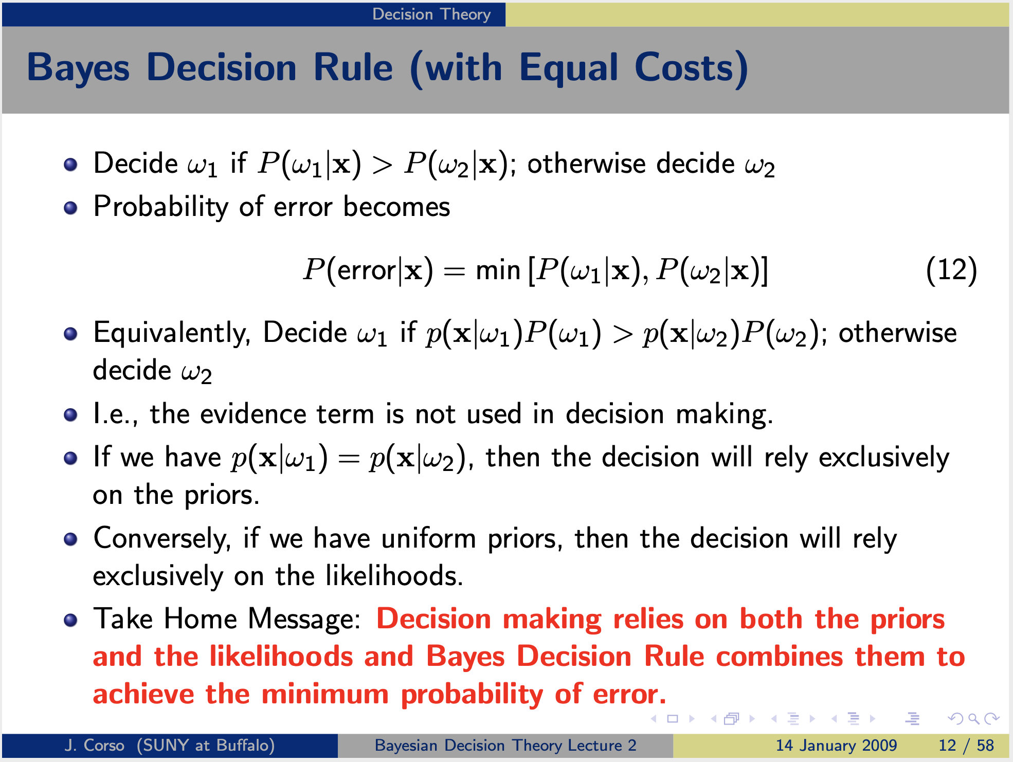

Slide 41
In This Lecture
What is Machine Learning?
Linear regression
Bayesian Learning
Deep Learning (DL)
Tutorial on DL

Slide 42
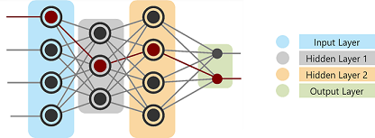
What's a Neural Network?
Built to mimic the functionality of a human brain
Human brain is made of billions of neurons
It has 3 important sections:
Input layer:
Hidden layers:
Output layer:

Slide 43
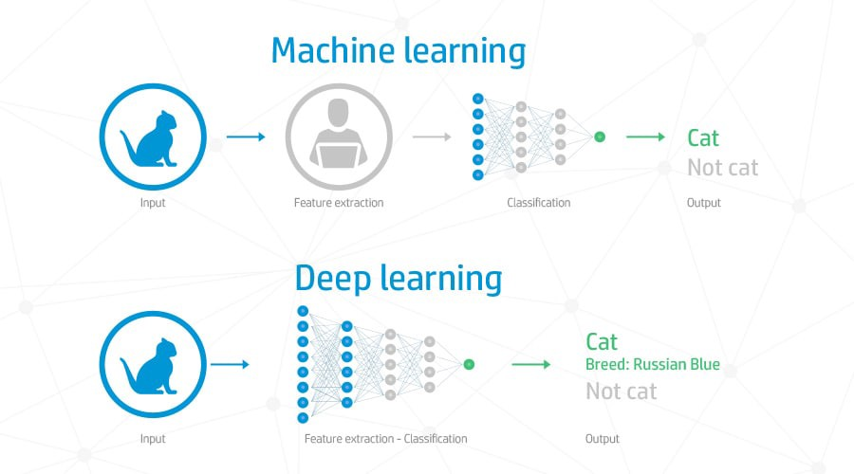
The Need for Deep Learning
Work with high dimensional data
Feature engineering is not required
Achieving performances better than humans

Slide 44
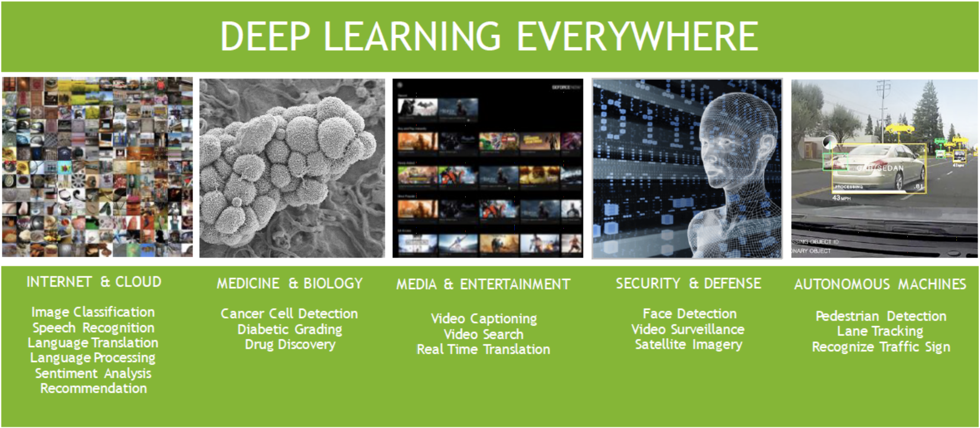

Slide 45
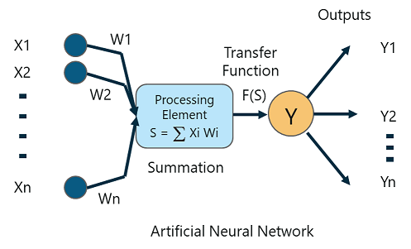
How Does A Neural Network Work?
A Perceptron is a single layer neural network that is used to classify linear data. It has 5 important components:
Inputs
Weights and Bias
Summation Function
Activation or transformation Function
Output class
Notes:
The inputs (x) received from the input layer are multiplied with their assigned weights w. The multiplied values are then added to form the Weighted Sum. The weighted sum of the inputs and their respective weights are then applied to a relevant Activation Function. The activation function maps the input to the respective output

Slide 46


Training a Neural Network

Slide 47
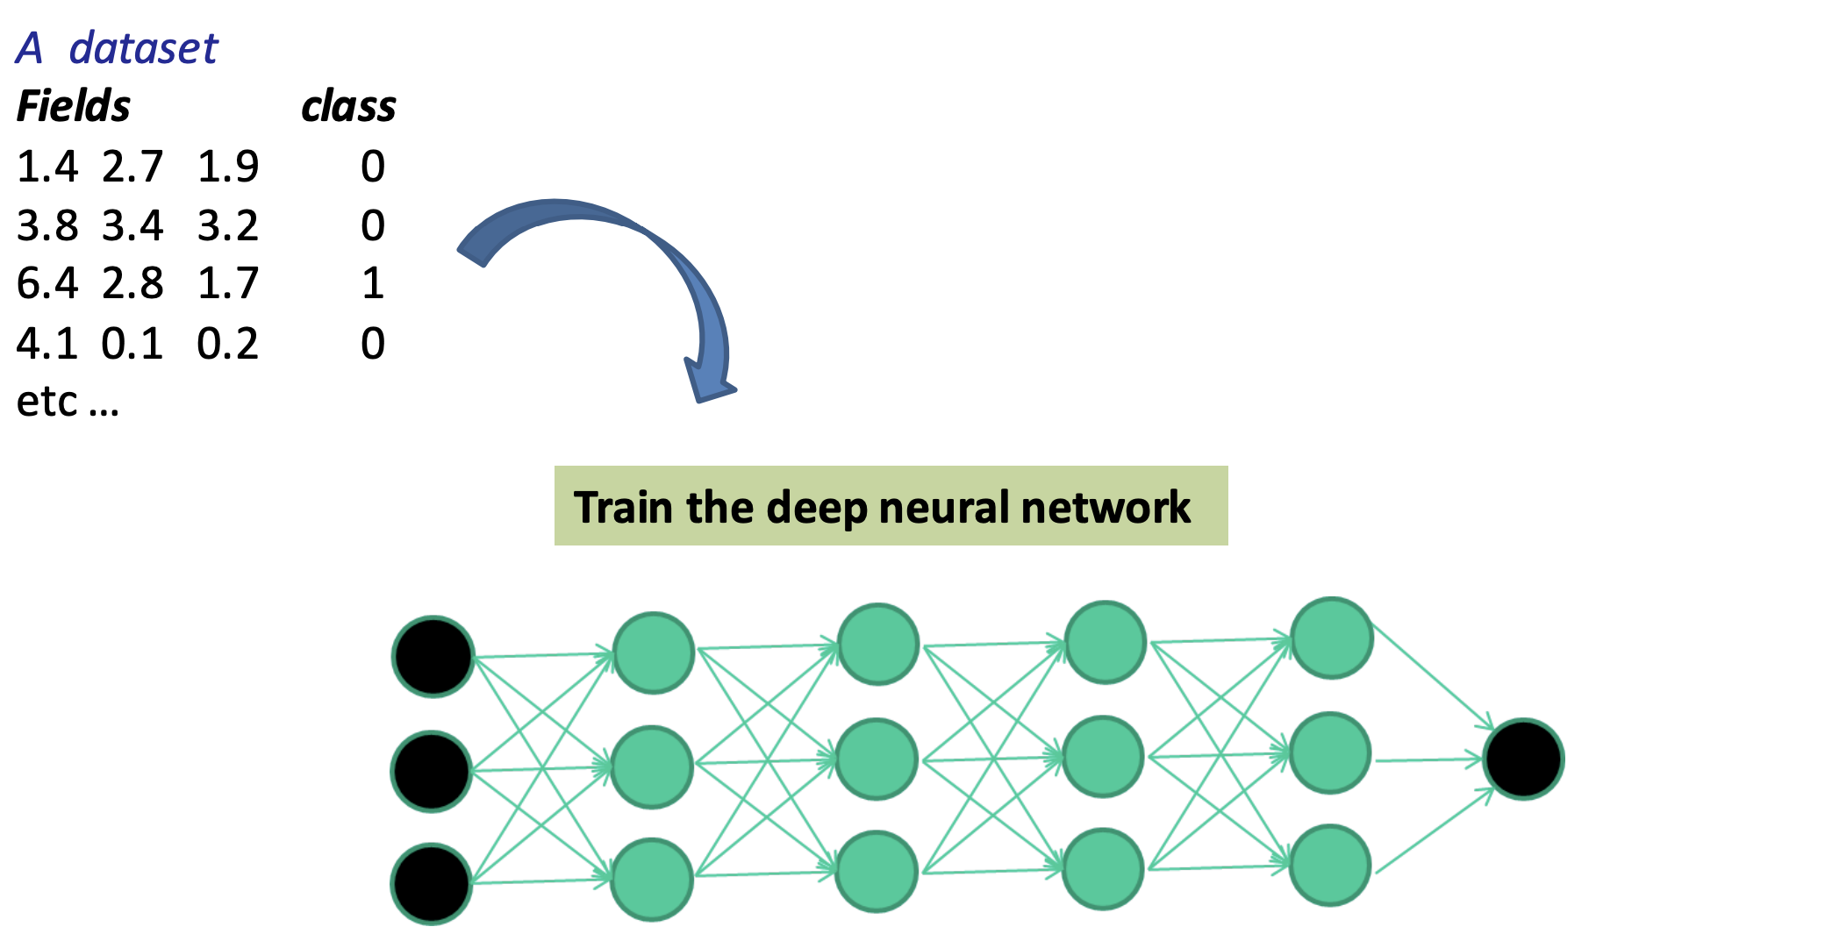

Slide 48
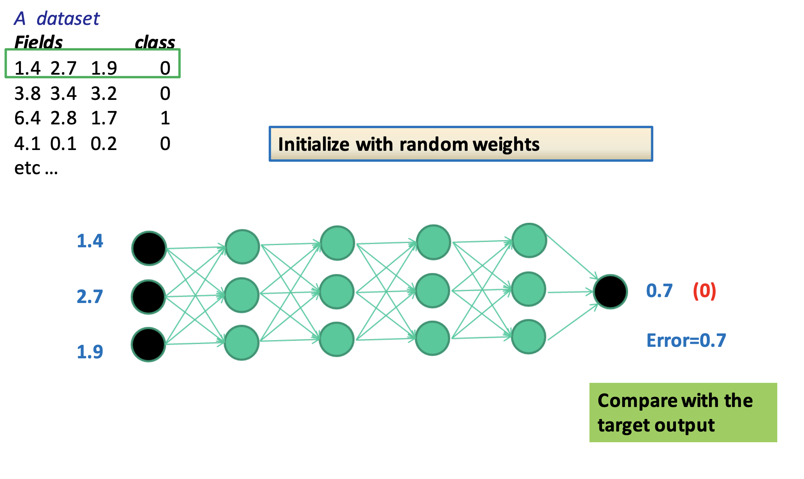

Slide 49
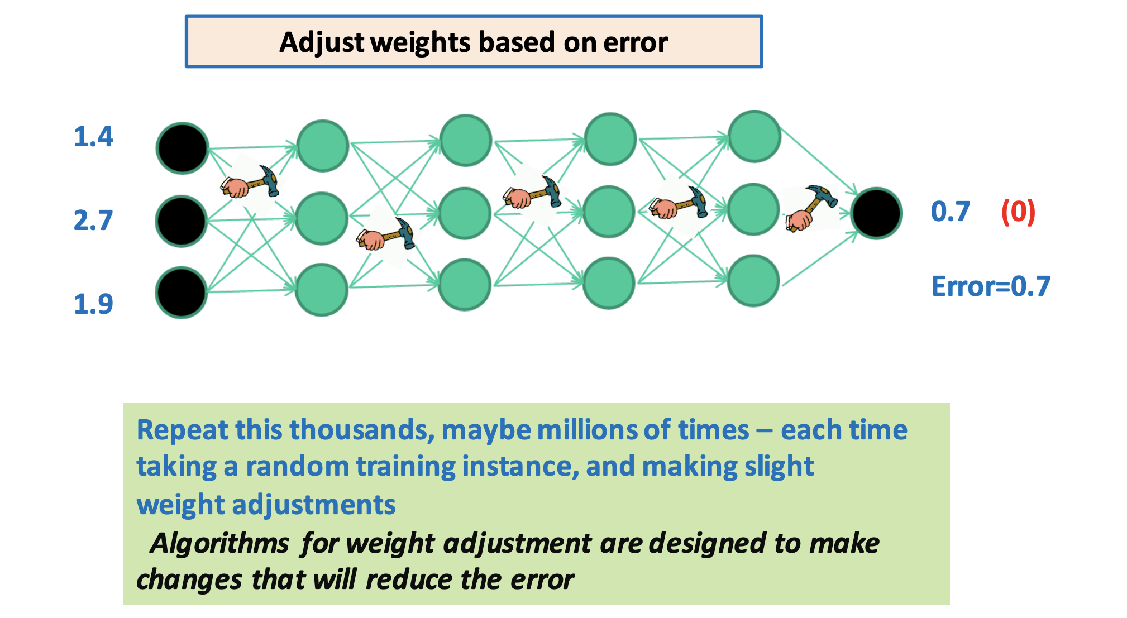

Slide 50


Slide 51
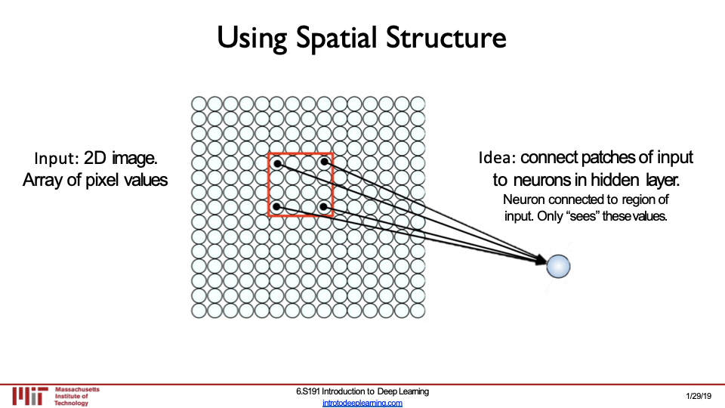

Slide 52
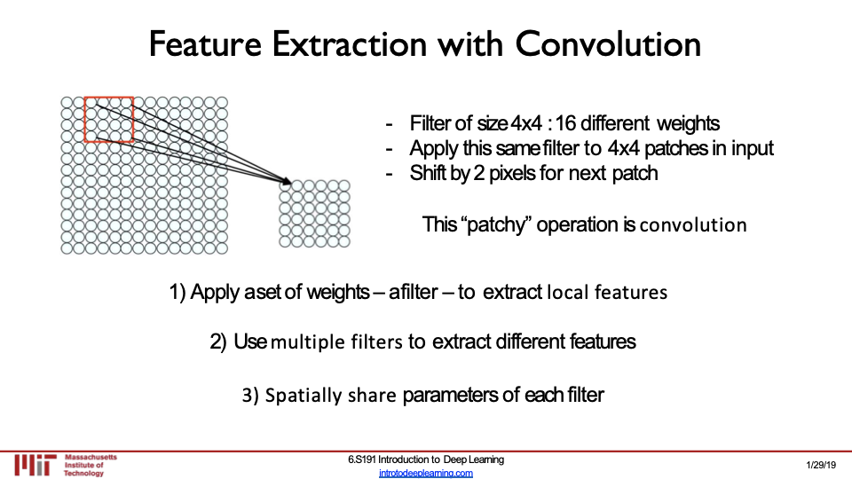

Slide 53
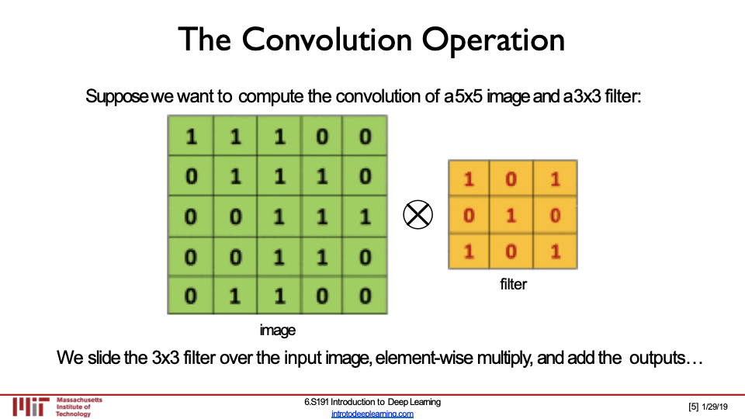

Slide 54
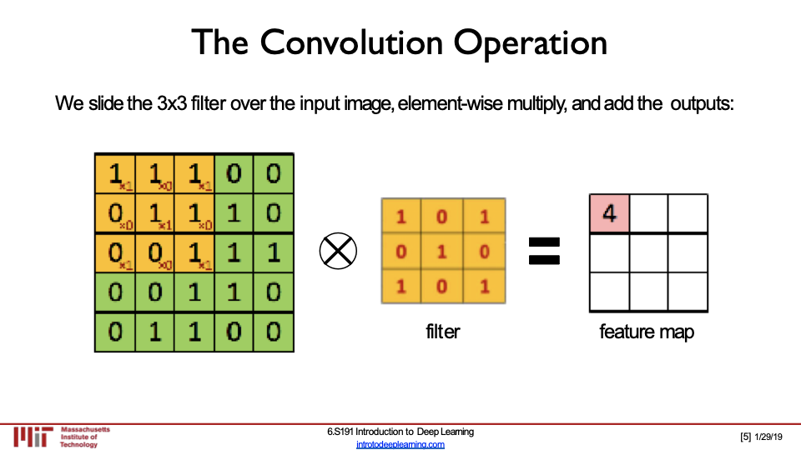

Slide 55
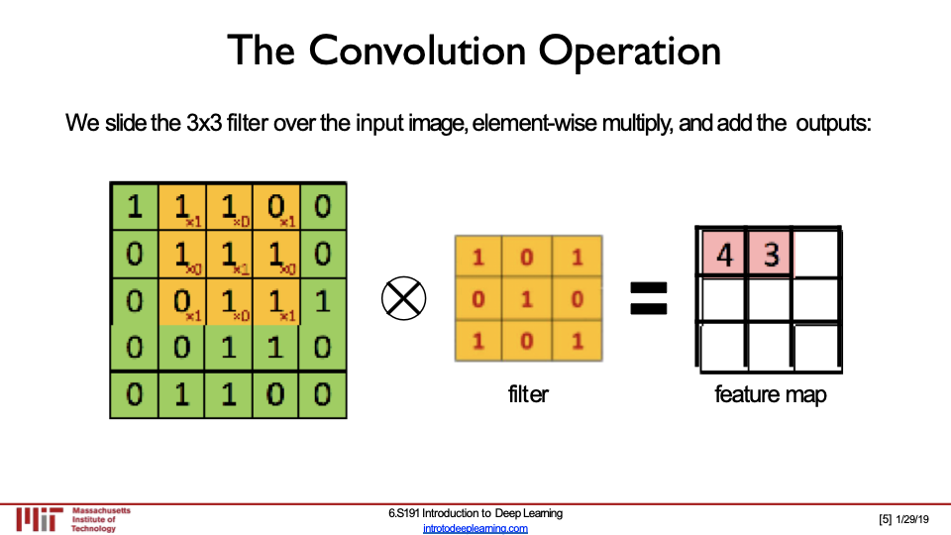

Slide 56
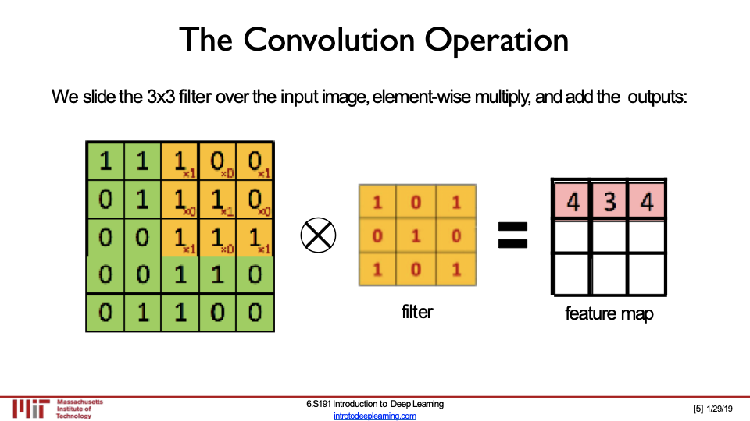

Slide 57
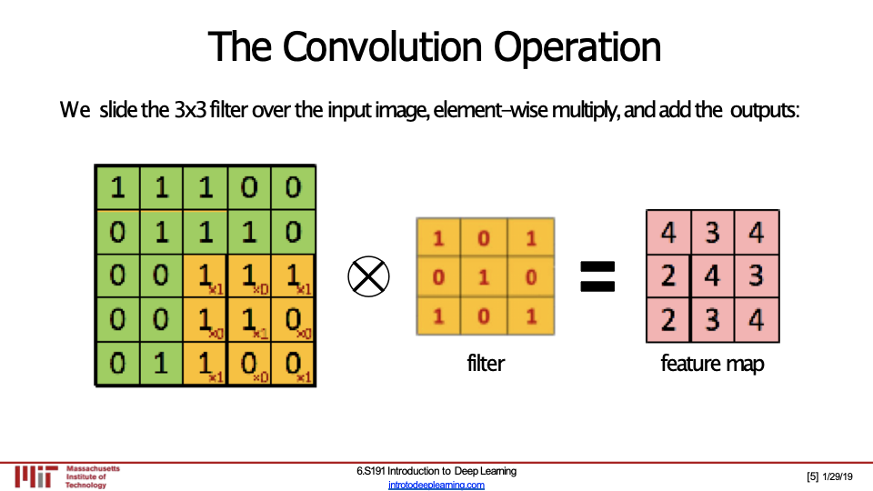

Slide 58


Slide 59


Slide 60


Slide 61


Slide 62


